Slide 1




Group ApolloX
“True Prosperity Index: Measuring What Really Matters for Communities”
Analysis of Wellbeing in California & New York Counties
Data Science Bootcamp
Final Project Presentation - Fall 2025
Instructor: Shaahid Ahmed Nadeem
December 1st, 2025
Members:
Chaitanya Kukreja
Matt Ghadimi
Arnav Daultani
Ferdi Fadillah
Daniel Adejumo

Slide 2






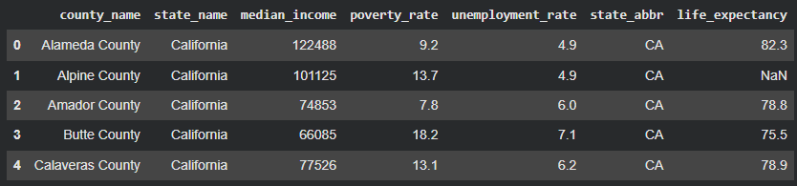

P A R T 0 1
Data & Indicators
List of Data Sources:
ACS: Income, Poverty, Unemployment
County Health Rankings: Life Expectancy
Geography: CA & NY Counties
Key Points:
“We combine economic + health indicators to capture real living conditions.”
“These 4 features are simple, interpretable, and widely used for social wellbeing.”

Slide 3






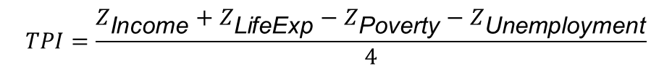

P A R T 0 2
mg8786@nyu.edu
mahdi-ghadimi-a5200a210
+1 (917)944-5293
github.com/mahdighadimii
mahdighadimi.wordpress.com
Constructing TPI
How TPI Is Built:
Step 1: Standardize all variables (Z-scores)
Step 2: Build a composite wellbeing score:
Step 3: Normalize TPI to a 0 – 100 scale
Key Insights:
Income & life expectancy improve prosperity
Poverty & unemployment reduce it
The final index is more people-centered than GDP or markets

Slide 4
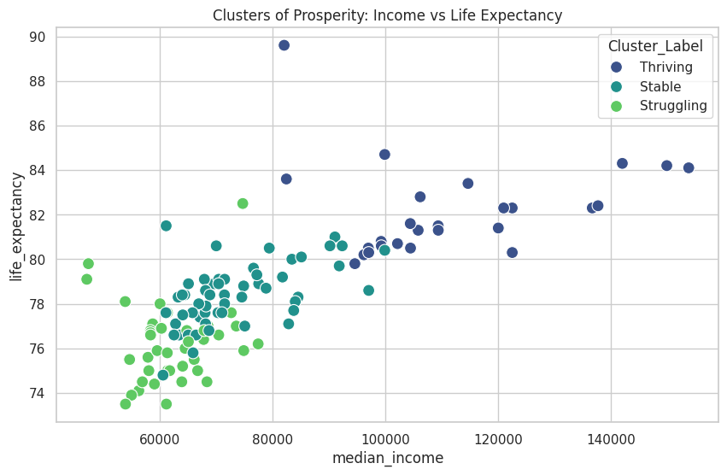
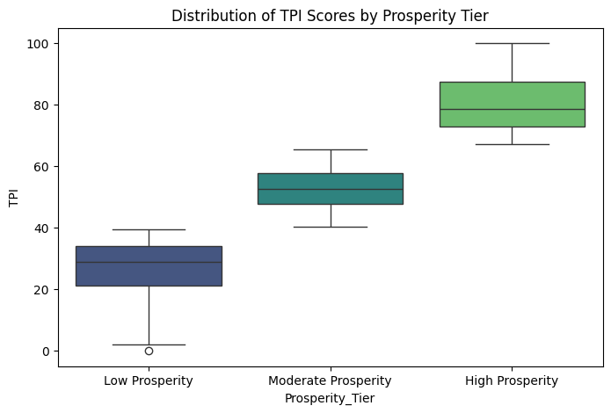

P A R T 0 3
Prosperity Tiers (Clustering)
K-Means (k=3): Low / Moderate / High Prosperity
What the Clusters Show
Low Prosperity:
Lower incomes, highest poverty & unemployment
Lower life expectancy
Moderate Prosperity:
Middle-class counties
High Prosperity:
High income + high health outcomes
Mostly Bay Area, LA suburbs, and NYC metro
Talking Points
“Even across two very different states, the tiers look surprisingly similar.”
“Prosperity inequality is real and sharply visible.”

Slide 5

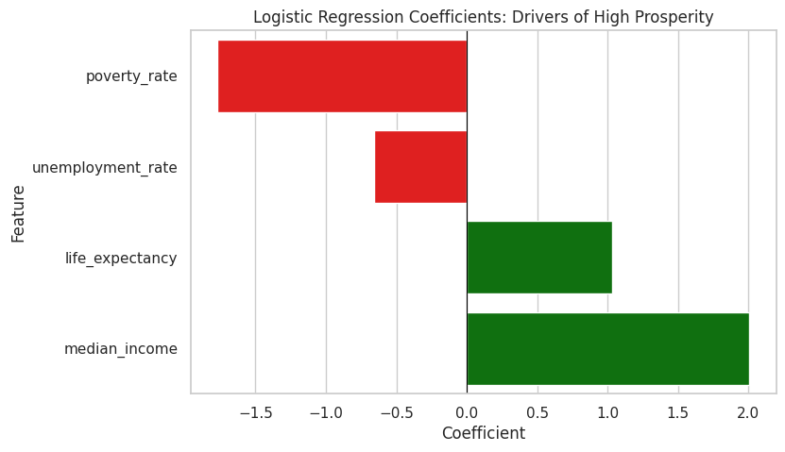

P A R T 0 4
mg8786@nyu.edu
mahdi-ghadimi-a5200a210
+1 (917)944-5293
github.com/mahdighadimii
mahdighadimi.wordpress.com
WHAT DRIVES HIGH PROSPERITY?
Logistic Regression: Which Features Predict High Prosperity?
Interpretation:
Poverty (strong negative) → Higher poverty dramatically reduces odds of high prosperity
Unemployment (negative) → Weak labor markets lower prosperity
Life expectancy (positive) → Healthiest counties tend to be prosperous
Income (small positive) → Once poverty & unemployment are included, income adds less
Takeaway:
“Poverty reduction and employment matter more than income alone.”

Slide 6

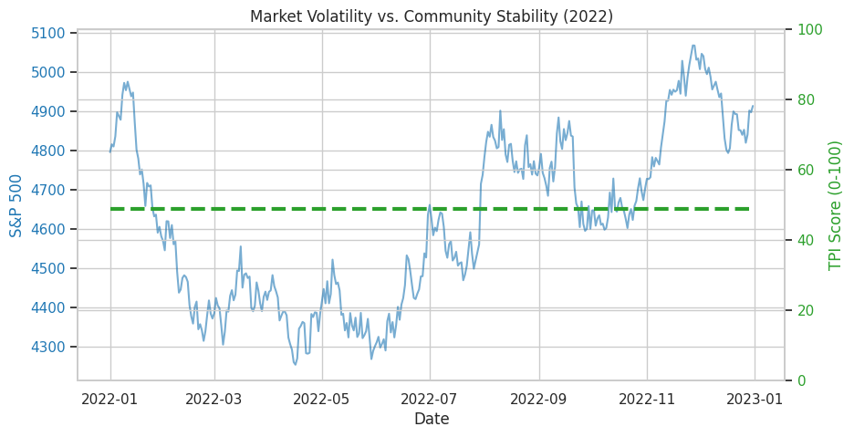

P A R T 0 5
mg8786@nyu.edu
mahdi-ghadimi-a5200a210
+1 (917)944-5293
github.com/mahdighadimii
mahdighadimi.wordpress.com
MARKETS VS PEOPLE
S&P 500 Volatility vs. Stable TPI
Interpretation:
S&P 500 jumps daily due to speculation, news, investor sentiment
TPI is stable, reflecting actual community wellbeing
The contrast proves:
“Financial markets ≠ community prosperity.”
Takeaway:
“The stock market cannot be used to measure how well people are living.”

Slide 7
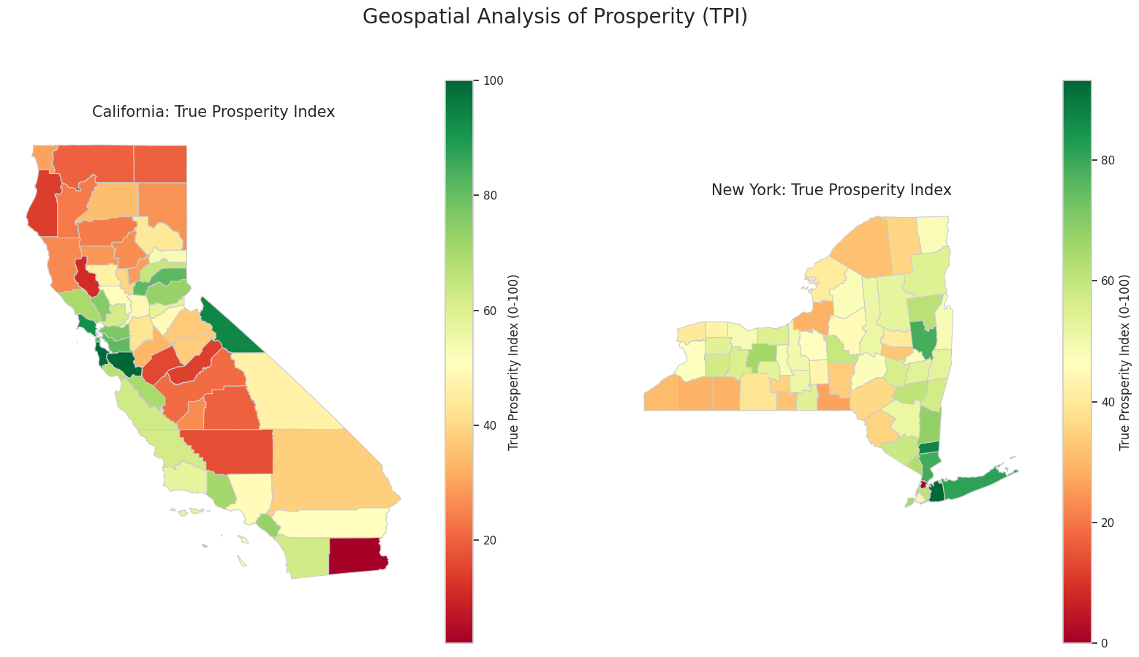
P A R T 0 6
mg8786@nyu.edu
mahdi-ghadimi-a5200a210
+1 (917)944-5293
github.com/mahdighadimii
mahdighadimi.wordpress.com
REGIONAL VIEW
Regions:
NYC Metro – High prosperity
Upstate NY – Much more Mixed
LA County – High but very uneven
Other CA – Many inland counties struggling
Takeaway:
“Prosperity is place-based, geography explains a lot.”

Slide 8


P A R T 0 7
mg8786@nyu.edu
mahdi-ghadimi-a5200a210
+1 (917)944-5293
github.com/mahdighadimii
mahdighadimi.wordpress.com
FINAL TAKEAWAYS
What We Learned
A people-centered index reveals inequality that GDP masks
Poverty, unemployment, and health are the strongest drivers of prosperity
The stock market is not a wellbeing indicator
Regional analysis shows deep internal inequality within states
Future Extensions:
Add education, environment, job risk, healthcare access
Perform causal inference or time-series trends
Expand national TPI for all U.S. counties

Slide 9


Thank you for your attention!

